Slide 1
Redefining URBAN Mobility
Notes:
Thank you for having me here today and it’s a pleasure to be share some of my thoughts on mobility and hear some interesting view today.
“Let me being by asking.. How many of you here are satisfied with the mobility solutions (they way it is, the options available)in the cities you live in.. ”
ANSWER
Now it is the time to change it and drive a revolution… “Jump to next slide"

Slide 2

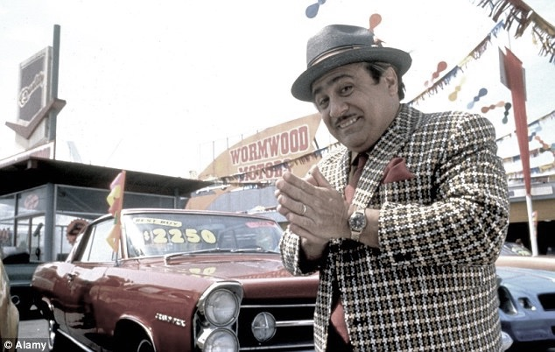
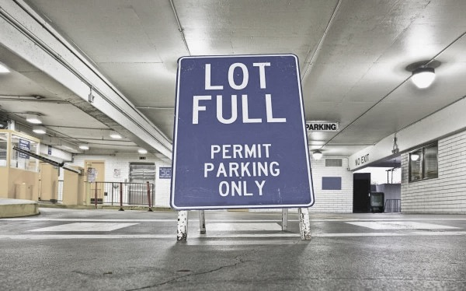

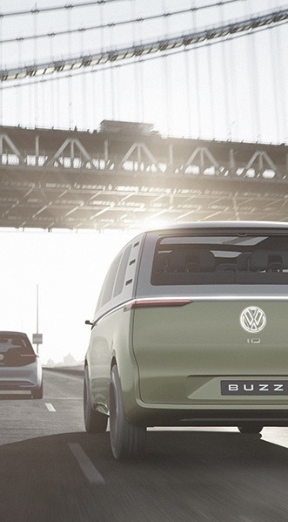
Because Most cities worldwide face similar traffic problems
64% of mobility in the world takes
place in urban areas
The average speed in London, Beijing and Shanghai is today ca. 10 km/h – as fast as horse-drawn carriage in 1900
congestion
ownership
Parking
STRESS
EMISSIONs and noise
Lack of alternative TECHNOLOGIES
3,5x Increase in personal kilometers¹ traveled in non-OECD countries until 2050
¹motorized and non- motorized Source: US Census Bureau; UN Population Division; Schaefer/Victor, 2000; ADL, 2012; KPMG, 2015; Audi Urban Future Initiative, 2013; stuttgart.de, 2017
Notes:
The reason for this disstatisfaction.. is
So far most of the focus in urban mobility has been evolutionary… “PAUSE”
What this evolutinalry approach has lead to is most of the
Cities today face similar problem :
Congestion, Parking , Emissions & a real lack of alternative
And this Is just going to increase as we go ahead from here “Next slide”

Slide 3
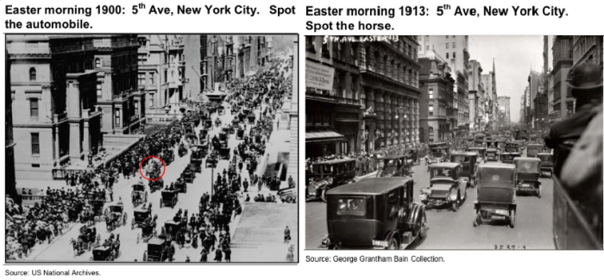
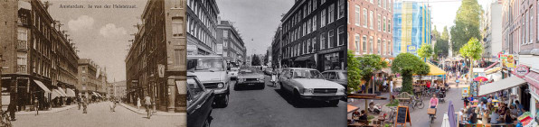
… And want to transform cities towards a desirable, sustainable future
Notes:
And People want to transform from where it is to a sustainable future..
Somewhere in the beginning of the last century things started to change for mobility when automotive boom was about to being…if you look at his interesting picture from 1905 to 1930
So that was the start of the problem and we are now tackling a century old problem.. “NEXT slide”

Slide 4
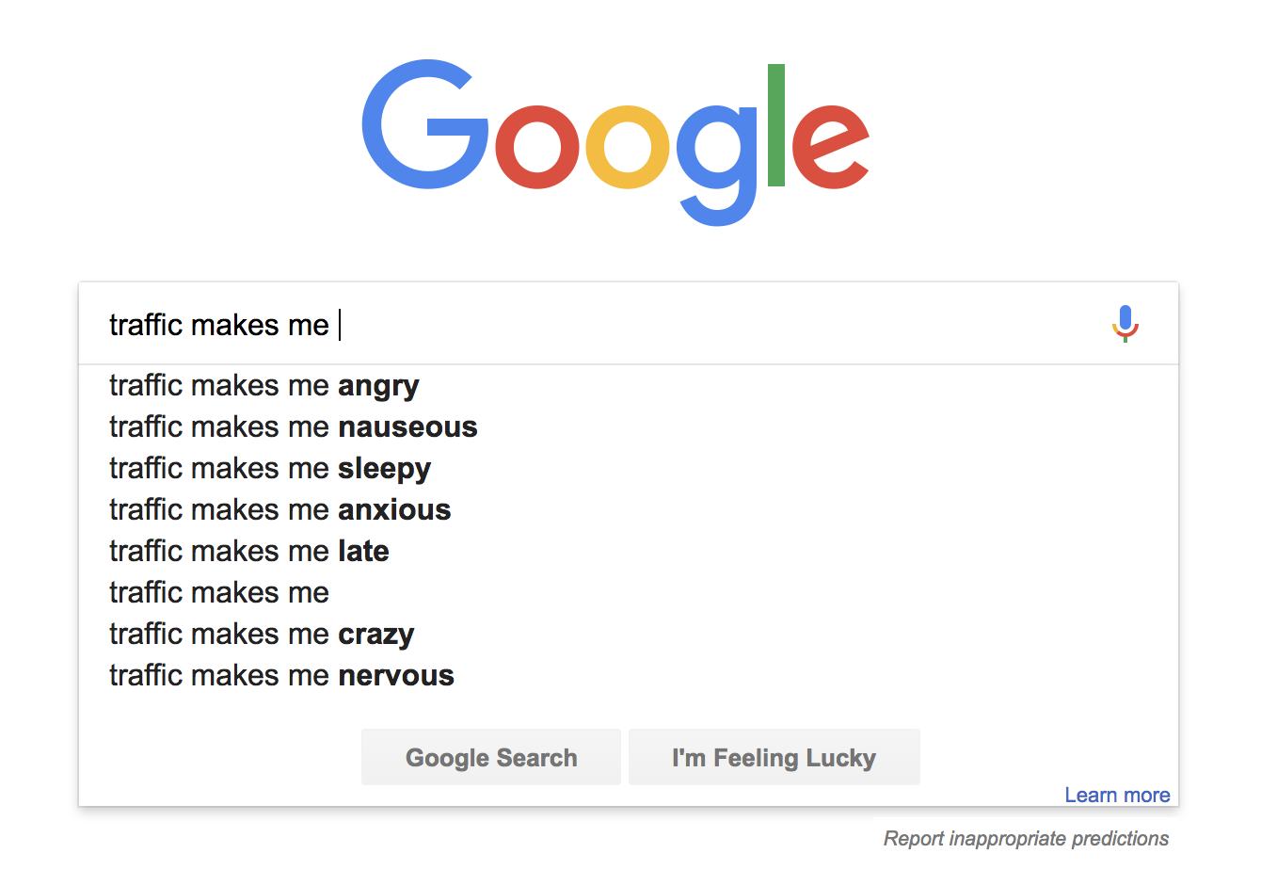
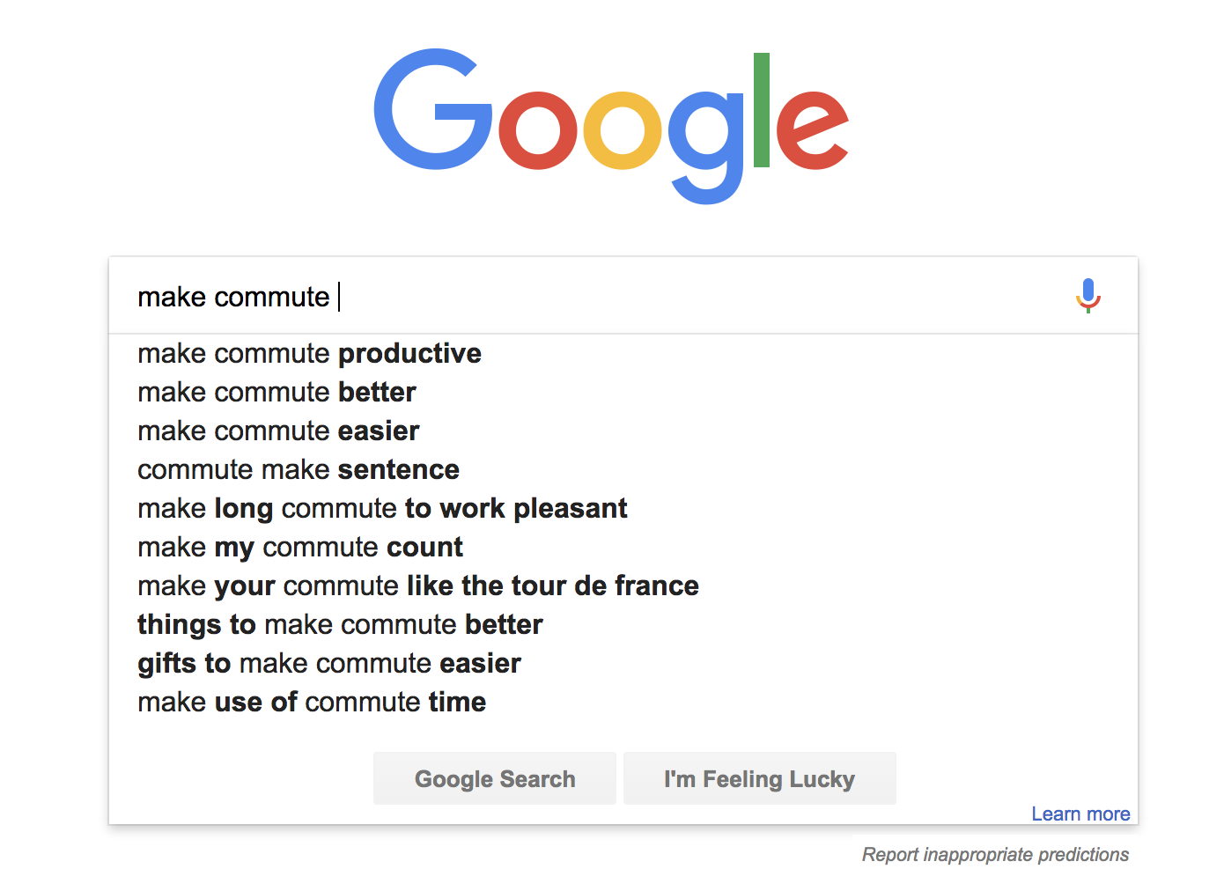
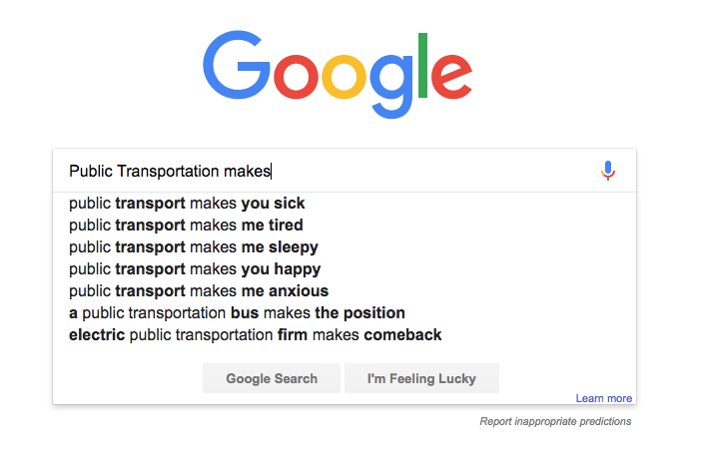
What people think……
What people Want…….
Notes:
But, before we start thinking on how to solve it lets look at what people really think is a real problem, what they want and if they have any solution.
A quick google search with these key words are enough for us to understand what people think of mobility & what they want..
“NEXT slide”

Slide 5













There are already several mobility options that aim to reduce urban traffic on the market.
Private Car
Ride Hailing
Taxi
Ride Pooling
comfort
Car Sharing
Tram
Subway
Scooter Sharing
Cycling
Bus
Walking
New Mobility Modes
price
Notes:
Like car sharing, bike sharing, pooling etc..

Slide 6
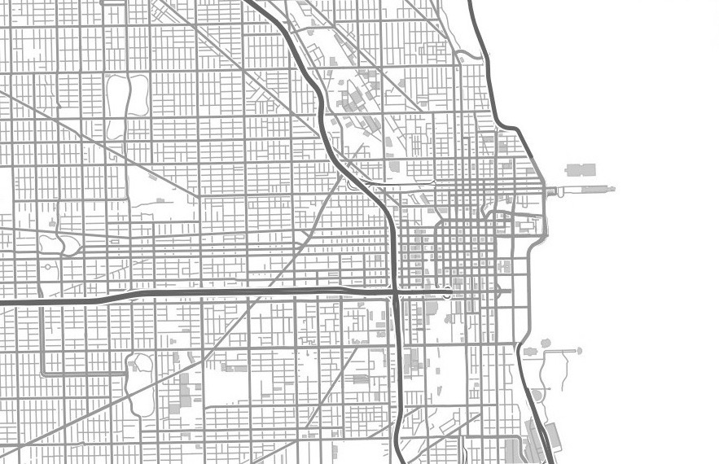
Ride Pooling will have the most siginificant relieving effects on urban mobility.
TRADITIONAL CAR USAGE
MOIA ON-DEMAND RIDE POOLING
Notes:
So At MOIA we believe that pooling will be the key for the new mobility dimension, which
But will this kind of pooled mobility help is reducing some the problems we have? “Any one with an option on this”..
Hmm.. not many convincining “yess””.. Alternative “nice.. Many yes;s.. More than I expected..”

Slide 7
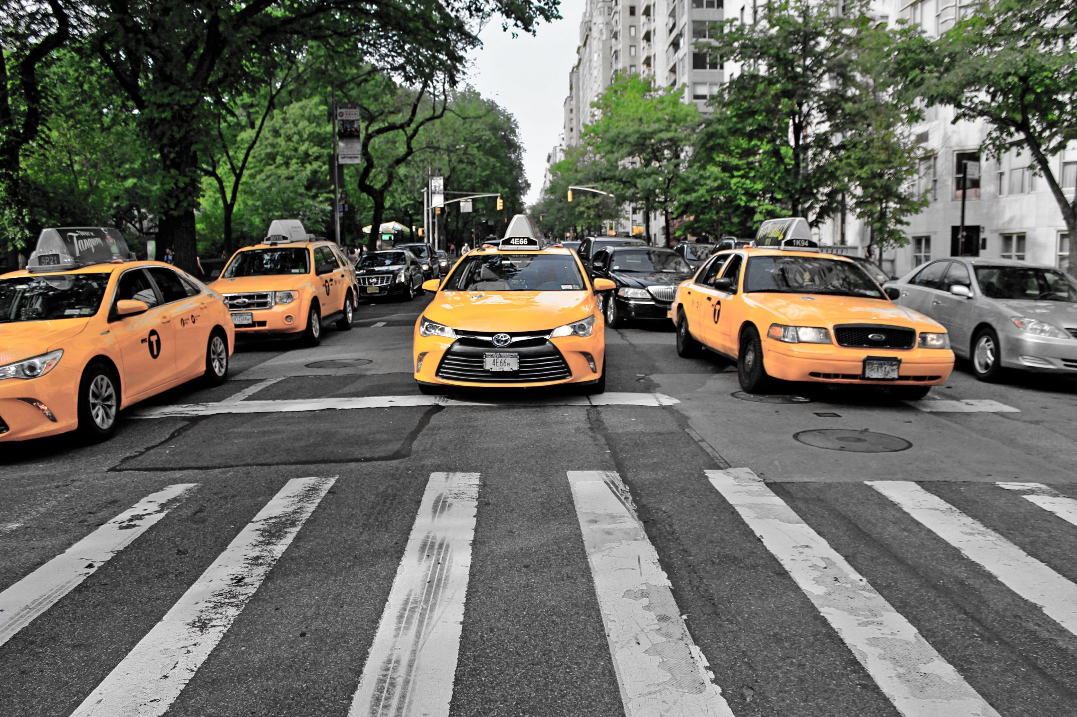
150
million
journeys
60
million
journeys
could
have
been cut
95%
could
have
been
shared
13.000
cabs
1 year
with less than 3 minutes delay
(40%)
PLACEHOLDER
Notes:
CONSIDER THIS
•Researchers from MIT, Cornell University, and the Italian National Research Council’s recently conducted a study into the impact of sharing on the 150 million trips recorded by over 13,000 New York City cabs over the course of a year.
- They discovered that 95% of all trips could have been shared – that means shared without inconveniencing any passenger by more than 3 minutes
- The total number of journeys in New York City could be cut by 40%. That’s 60 million car journeys per year!

Slide 8
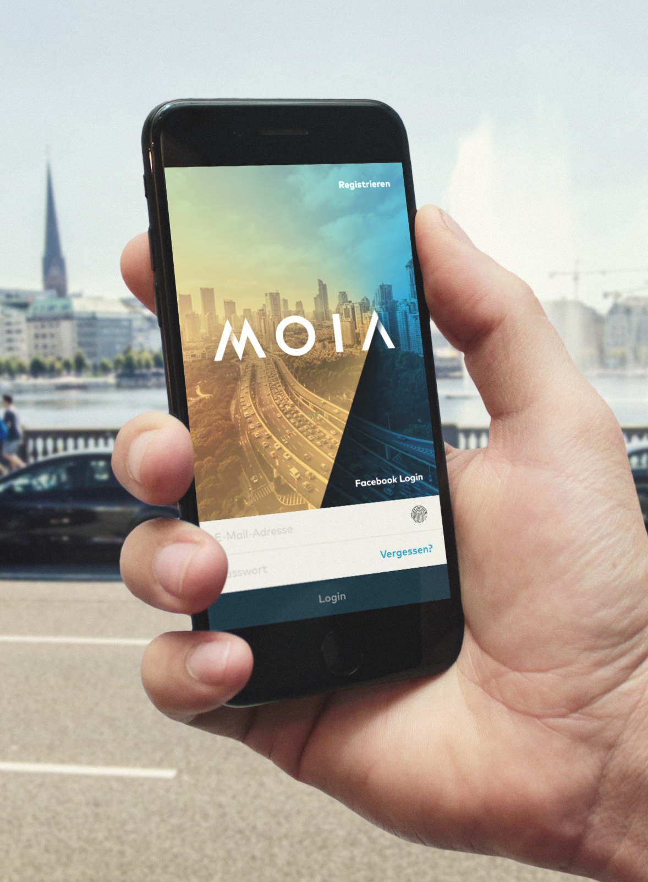
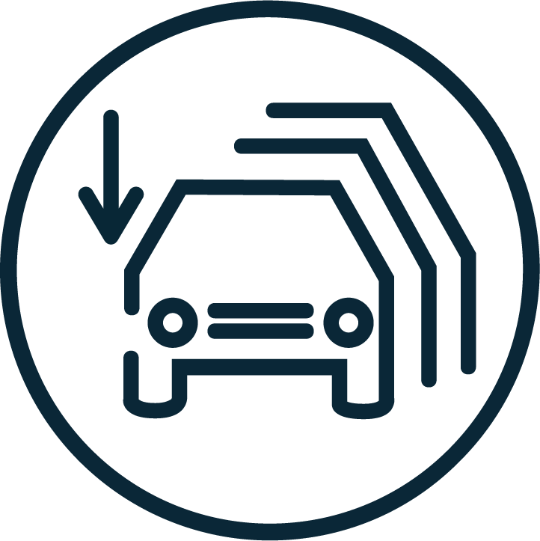


ON DEMAND SHUTTLE
Shuttle-on-demand has the MOST SIGNIFICANT impact on urban traffic
The "MOIA Effect" in
Plan for 2019:
1.000
Shuttle Vehicles
-9.000
Cars PER
1.000 SHUTTLES²
-1,2% CITY CO₂
Per 1.000 SHUTTLES^{2,3}
-1,2% CITY NO_{x}
Per 1.000 SHUTTLES^{2,3}
¹ Mobility in Germany 2008: Modal Split in Hamburg; ² First estimation: Substitution rom 6.000 to 12.000 cars or 0,8% to 1,6% of overall emission caused by innercity car traffic ³ Emission through electricity generation for MOIA On-Demand-Shuttle not included

Slide 9






different life phases bring a Huge potential for different MODES of mobility solutions
Young adult
Adult
Parent
Old adult
Retiree
WALK
BIKE
PUBLIC TRANSPORT
SHARED MOBILITY
VEHICLE OWNERSHIP
Notes:
Does it mean it will serve all the use cases we have in our cities… probably not..
I mean a quick look at the demographics of the city will clearly present the needs of people and what mobility type they are seeking to have..
This is where MaaS as a concept becomes relavent and service providers need to think on how they can make mobility seamless..

Slide 10

Interaction needed between all the involved Stakeholders
Service Characteristics
Detour Ratio
Waiting time
Capacity
Road Restrictions
Station Distance
…..
Out Vehicle Time
In vehicle Time
User
Occupancy &
Utilization
Fleet Size
Fleet Operator
City
Congestion & delays
Notes:
To achieve seamless mobility …
Data plays crucial role to play in the new Mobility defintion, data coming from all of these stake holders will be and is crititcal to understand the unique needs and provide unique solutions..
And mind you these solutions will have to be tailored to cities because cities as individuals have different characteristics and will need solutions which can be tailored.
Think global but act local “Next slide”

Slide 11
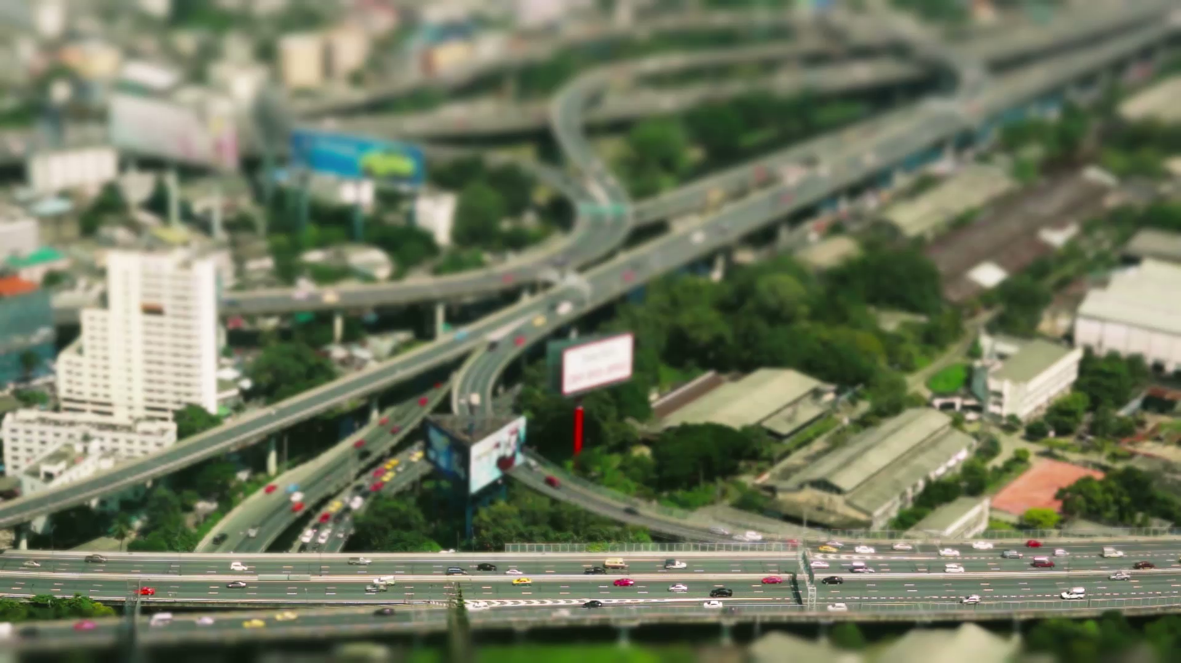




Making it work – END-TO-END
CUSTOMER INTERFACE
Fleet Operation & Algorithms
Vehicle Design
Notes:
Towards the end.. What is really ciritiacal is how can we make it the solution work end to end.. Right from the interfact to the the vehicles..
For that we need to PRIORITIZE PEOPLE OVER VEHICLES give them an accessible mobility solution where the data infrastructure underpinning the shared transportaiton must enable interoperability, competition and innovation, while delivering privacy, security and accountability.
To conclude…
“Started with Horses… moved to horse power.. Now it is our time to power mobility with data and algorithms… ”

Slide 12
#moiamobility
www.moia.io
Notes:
We have started our journey of revolution at MOIA… and hope more people join this social movement

